Slide 1
Chapter 8 Vocabulary
By Hannah Montana
7th Grade Superstar

Slide 2
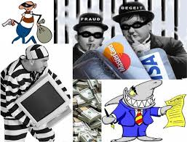
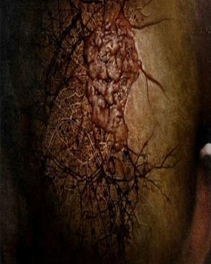
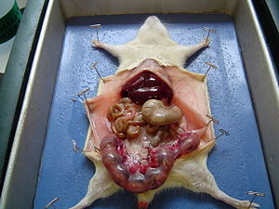
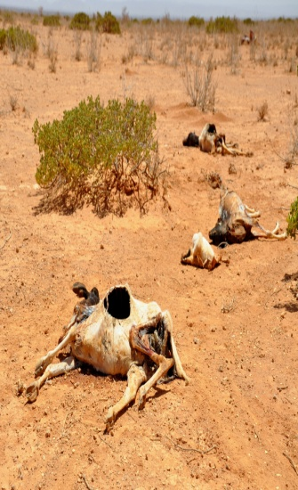
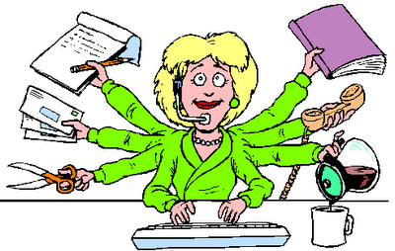
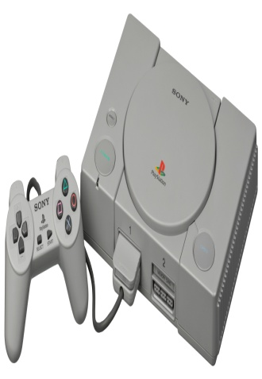
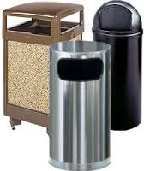
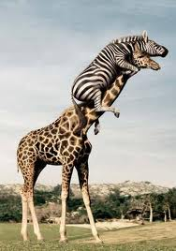
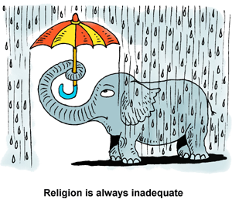
Collage

Slide 3
Word, Definition, two synonyms, two antonyms (if there are any)
Afflicted: suffering with, troubled by, (s) misfortune, torment, ordeal misery (a) relief, comfort
Bilk: to cheat out of money, to defraud, (s) swindle, victimize, bamboozle, rip-off
Commend: to praise, to call attention to, to recommend, (s) congratulate, compliment, honor, (a) criticize, censure
Delicacy: fragility, softness, something pleasing to the senses, (s) weakness, elegance
Diminutive: very small (s)miniature, minute, little, (a) large,, big, huge
Dissect: to cut apart or separate, to examine, (s) lay open, analyze , break apart
Endeavor: a good try or attempt (s) effort, struggle, venture, undertaking, aim
Famine: serious shortage of food, (s) scarcity, lack, destitution, (a) abundance, feast, bounty
Frail: not strong or heavy (s) weak, feeble, delicate, sickly, (a) healthy, robust, strong sturdy
Hectic: marked by feverish activity, hasty, (s) frantic, chaotic, turbulent confused, (a) placid, calm

Slide 4
Sentences using Chapter 8 Vocabulary
Mr. Madoff, an investment banker, bilked innocent customers out of millions of dollars.
Famines are devastating to countries that must endure months without water.
Her hectic schedule caused her to have a nervous breakdown.
My teacher scrutinized our powerpoint projects to make sure that we followed directions.
Our inadequate funding prevented us from going on the trip to Disneyland.
In science class, we dissected a frog and it grossed me out.
It is plausible that the child plotted to kill her parents because she couldn’t watch Justin Bieber on television.
The Atari video game is currently obsolete.
The waste receptacle in our classroom is next to the entrance to the classroom.
His afflction caused him to be sidelined for the rest of the football season.

Slide 5
Letter to a friend using four vocabulary words.
Dear Sharon,
Our friendship began in seventh grade science class and as partners, we had to dissect that humungous frog. I still get goosebumps just thinking about it. My current affliction prevents me from attending school, so I need your help. My frail body has left me with little energy. It is difficult to even sit up in bed. I realize your schedule is hectic, but can you drop off my homework for the week on Monday after school? I would appreciate it so much if you could. I don’t want to fall behind so I’m reaching out to my best friend for help. I can’t speak on the phone, but I can text, so that is what I’ve done. Please stop by after school.
Your friend forever,
Maggie Pye

Slide 6
Advice Column Please respond to the Letter
Dear Catamount,
My best is a cleptomaniac or otherwise known as 88 fingers. Basically she is a
thief. She watches students in class who play with their cellphones and then comes
up with a scheme to get their phones. So far, she has stolen six phones and then
brags about it to me because she says I’m her best friend and friends don’t snitch.
What! Who came up with that stupid law? Help! What should I do? I’m really
feeling uncomfortable right now. I feel so bad for her victims especially when I see
them searching frantic ally for their phones. I need help quickly.
Sincerely,
Friend of a Cleptomaniac

Slide 7
Obituary Create a fictitious obituary for Chapter Seven Vocabulary Words
Directions:
Full Name
Date from – Date To
(Name of Person) (Age) passed away on (date) in (location). (First name) was born in (City,State) on
(date of birth). (He/She) is survived by names and roles of living family members). And was predeceased
by (names and roles of family members who have died.
(Memorial/Funeral) services will be performed at (location) on (date) at (time).
See sample below.
In Loving Memory
Chapter Seven Vocabulary Words
Thursday, October 30, 2014 to Friday, November 7, 2014
Chapter Seven Vocabulary Words, 9 days old, passed away on Friday, November 7, 2014 in Room 222 at
Coulwood STEM Academy. Chapter Seven was born in Charlotte, NC on October 30th. He is survived by
Chapters Eight through Twenty-Five, who reside in Spartansburg, South Carolina and was predeceased by
Chapters One through Six.
Memorial Services will be performed at Coulwood STEM Academy on Monday, November 10, 2014

Slide 8
Acrostic Poems Use words and phrases to create an acrostic poem for one of your vocabulary words. See the examples below
Dissecting Day in Science Class
Despair was written all over my face
In front of me lay a despicable dead frog
Scissors so tiny to open him up
Scents of formaldehyde filled the room
Embarrassed by the groans from my queasy stomach
Called for reinforcements to help me through it
Together we got the job done, I think it was rather fun.
Frail Little Jimmy John
Feeble little Jimmy John
Rolled himself off the couch with a “Thud!”
And broke his tibula in fourteen places
Instead of calling the doctor, he moaned and groaned and
Laid upon his bed and said, “I’m

